Slide 1
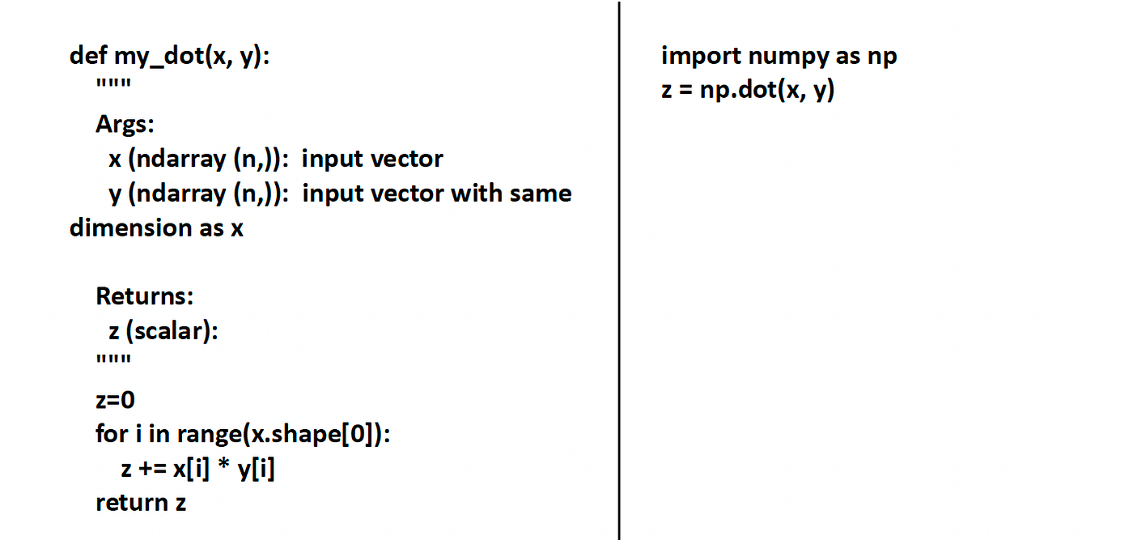
The End of the for Loop
The Problem: Standard Python loops are slow because they process one item at a time (Scalar operations).
The Solution: Vectorization allows you to perform math on entire datasets simultaneously.
Speed: NumPy operations are often 100x faster than standard Python lists because they are implemented in C.

Slide 2
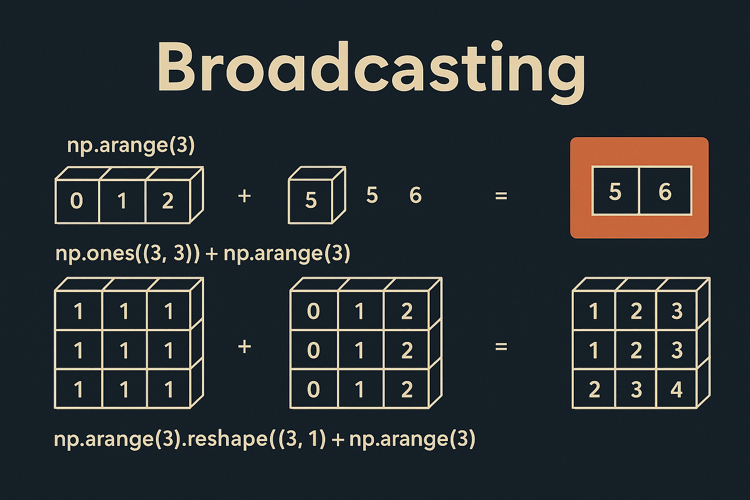
Broadcasting – Math Between Different Shapes
Definition: The ability to perform operations between arrays of different shapes (e.g., adding a single number to an entire matrix).
Mechanical Necessity: This allows for memory-efficient computation by "stretching" smaller arrays to match larger ones without actually copying data.

Slide 3
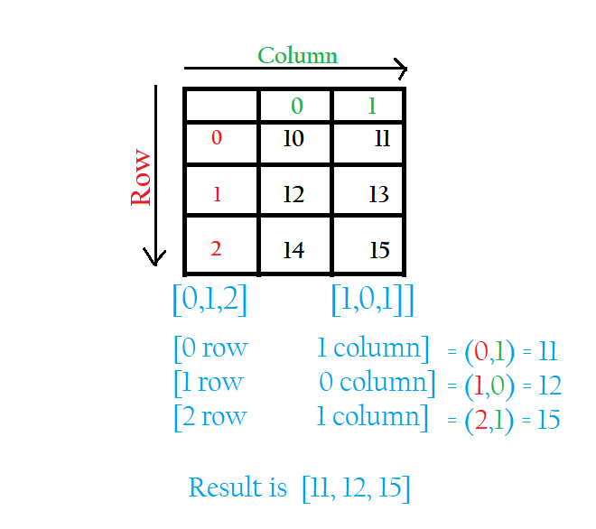
Slicing and Fancy Indexing
Data Extraction: Pulling complex, non-contiguous patterns out of massive numerical grids.
Fancy Indexing: Using arrays of integers or booleans to "pick and choose" specific data points from a 2D or 3D space.

Slide 4
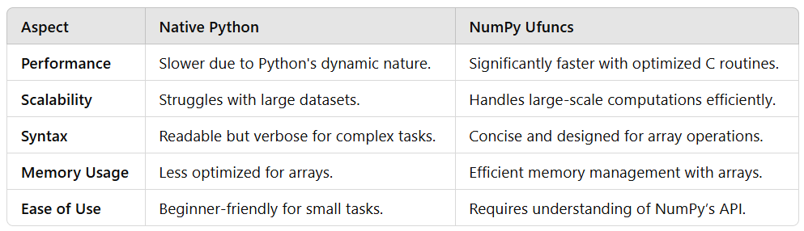
Universal Functions (ufuncs) & Simulations
ufuncs: Highly optimized mathematical functions (Sine, Log, Exponential) that operate on millions of points instantly.
Randomness: Generating "synthetic" or "fake" data for simulations and model testing.
Use Case: Simulating a year of crop yield or financial market fluctuations in milliseconds.

